Slide 1


Web designing software.
WordPress

Slide 2
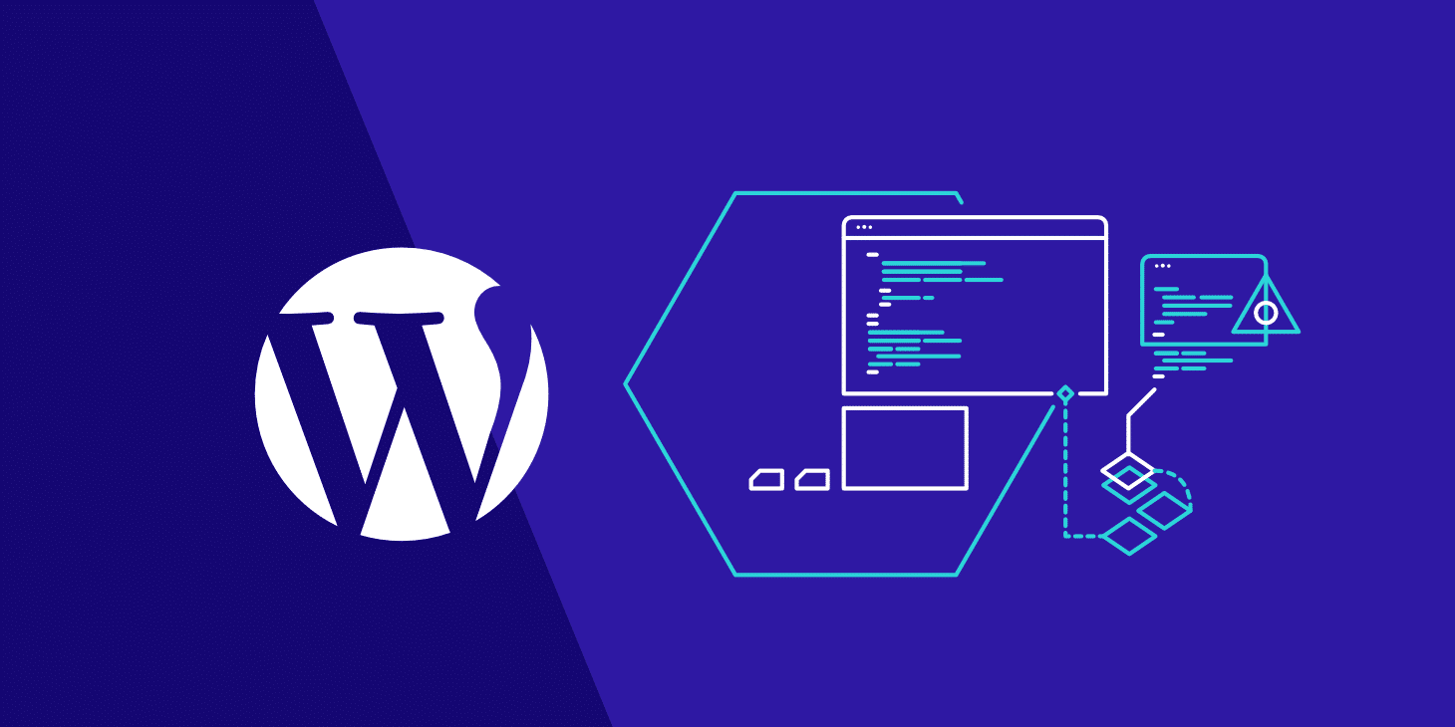
Word Press Overview
Introduction
What is Wordpress ?
Benefits of Wordpress
How does WordPress work?

Slide 3
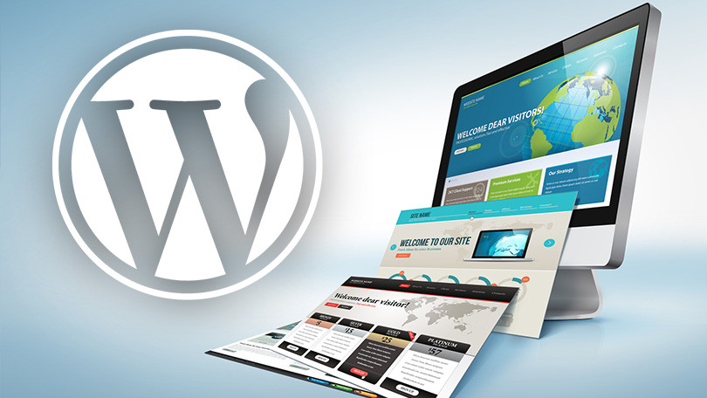
Introduction
WordPress is a free and open source Content Management System(CMS) framework. It is the most widely used CMS framework of recent time. Let us now have a brief discussion on what is CMS and what is Wordpress.

Slide 4
What is Wordpress ?
WordPress is a content management system (WCM) i.e. it is a tool that organizes the whole process of creating, storing and showcasing web-content in an optimal way. WordPress started its journey as an improvement tool to enhance the regular typography of day to day writing. But it was taken as a blogging tool and as we reach the last quarter of this year WordPress stands strong as the most used WCM system used and that also not only in the blogging community.

Slide 5
Benefits of Wordpress
EASY TO INSTALL
To get started with WordPress is a breeze as it has a simple and quick process of installation. All you need to do is to creating your web pages online and uploading the database. If using the FTP program, just create a database and then upload WordPress; subsequently install it to get started.
EASY TO USE
The most vibrant feature of WordPress is its ease. Anyone can become expert while playing with the software because it has an intuitive interface. It comes with an inbuilt dashboard where users can add new pages, posts, or categories, change themes and settings, and much more. The open-source platform comes free which makes it a cost-effective option.

Slide 6
Benefits of Wordpress
RESPONSIVE DESIGN
As mobile has become the best place to fetch traffic for business websites, they need to be responsive to reach the potential buyers on the mobile channel. WordPress offers a responsive design which ensures that your website runs seamlessly on different devices, without having to put in extra effort for developing separate websites to run on them.
MEDIA MANAGEMENT
Images, videos, and other media elements can be added easily to your WordPress website to enhance the richness of its content. It offers a drag-and-drop system that allows you to drag the media content and drop it into the uploader easily to get it uploaded. You also have access to image editing tools if needed.

Slide 7
Benefits of Wordpress
MULTIPLE THEME OPTIONS
Themes decide the look and navigation of the site. With WordPress, there are multiple options in themes that can be customized according to the business requirements. Users can download the themes according to the category and need and play with them to build appealing websites that replicate their business brand with an impressive online presence.
PLUGINS FOR CUSTOMIZATION
Plugins are the backbone of this platform. By making use of plugins, users can customize the site and add the desired features and functionalities to it. All that is needed to be done for adding a new feature to the site is to install a plugin. And amazingly, there is a large number available and most of them are free of cost or reasonably priced.

Slide 8
How does WordPress work?
WordPress, like any other WCM system, is dynamically driven through the use of a database with multiple tables storing all the content information and the information required to specify the website structure. You must have the ability to create and utilize a database to use WordPress. The internal structure and database structure are one of the more advanced topics and will be resumed in later articles.
After learning about the WordPress the first thing that comes to our mind is that where to use it? What kind of website can I create using WordPress? So let’s move on to the section straight away.
When launched, WordPress was nothing but a typographic improvement, but as time passed and the community got stronger and WordPress was developed by contributors from all over the world, now WordPress is a robust system that can be used to create and manage any kind of website to keep it short. To showcase some examples lets look into the various implementations of WordPress already developed.

Slide 9
Thank You

